Slide 1
2017

Slide 2
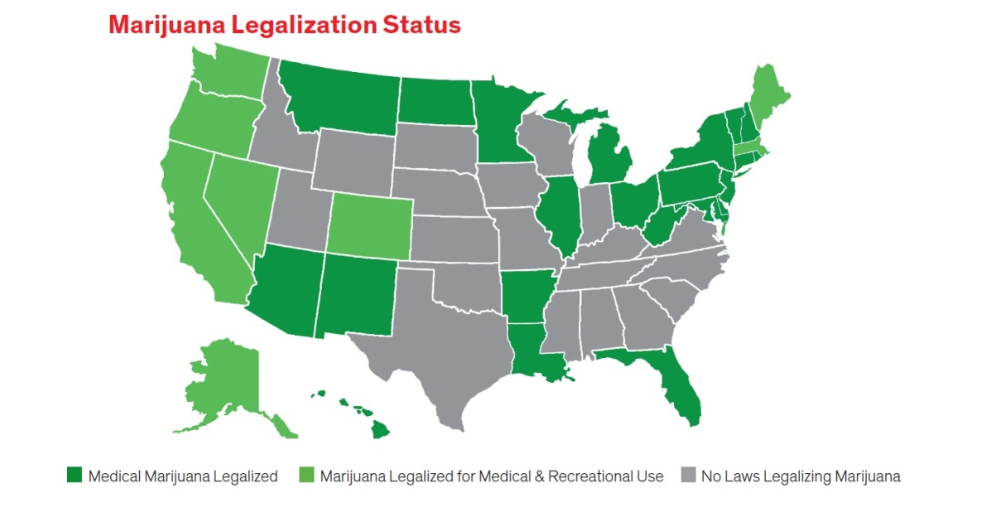
What Has Been Happening to the South
Currently 29 states, 3 indigenous nations, and the District of Columbia have legalized medical cannabis
Currently 8 states have legalized recreational cannabis
Federally all is still illegal

Slide 3
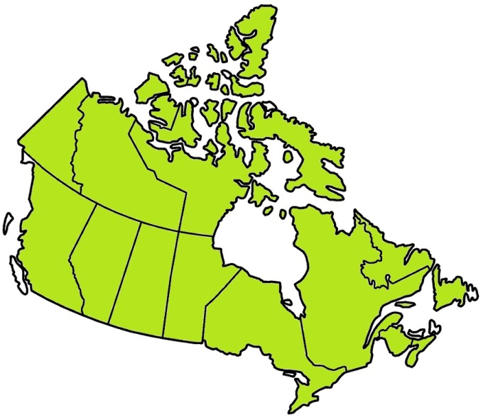
Current Legal Status in Canada
Cannabis (marijuana) remains a Schedule II drug under the Controlled Drug and Substances Act, and, unless otherwise regulated for production and distribution for medical purposes, is subject to offences under that Act.
Possessing and selling cannabis for non-medical purposes is still illegal everywhere in Canada.

Slide 4
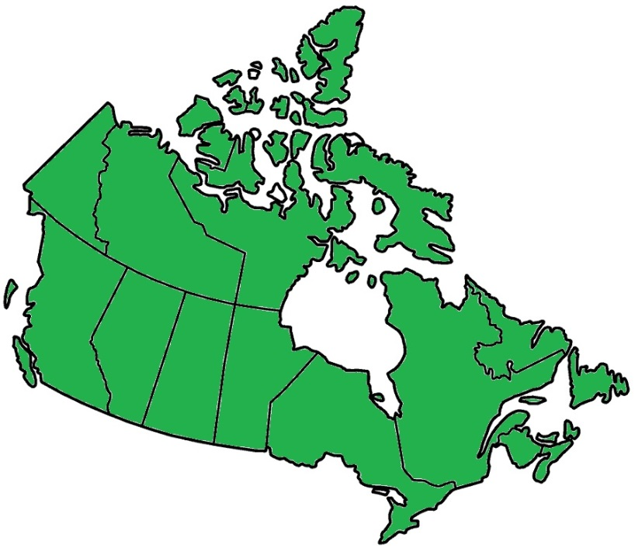
Pending Legal Status in Canada (Recreational)
The final wording was still under discussion but a “likely” date for the official effect of the legislation has been widely publicized as 1 July 2018. The provinces will have the power to determine the method of distribution and sale.

Slide 5
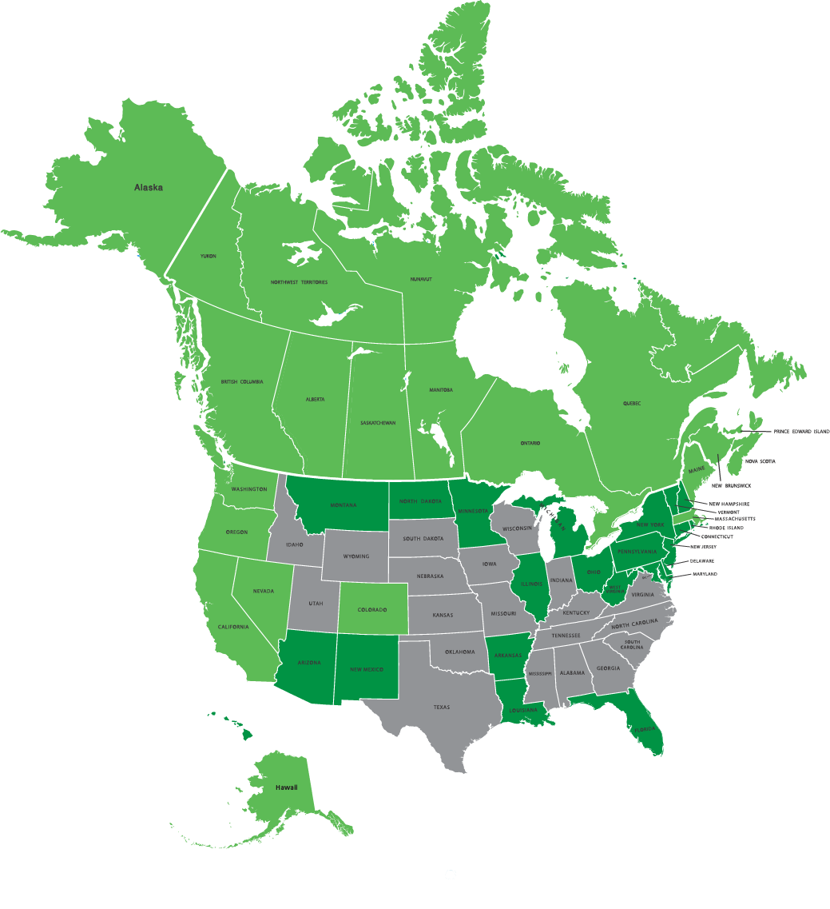
Marijuana Legalization Status
Medical Marijuana Legalized
Marijuana Legalized for Medical & Recreational
No Laws Legalizing Marijuana

Slide 6
A Very Different Industry With Unique Challenges
Lack of experience within the engineering community
Lack of HVAC experience in the operator community
Lack of consensus within the grower community
Latent cooling , latent cooling, and latent cooling

Slide 7
My Personal Experience So Far, a Very Steep and Confusing Learning Curve
We have supplied equipment to multiple grow facilities over the last 4 years
Sought out experts to educated myself so I can assist engineers
Initially modified 5 ton data center CRAC units to better suit the grow space
Partnered with an industry leader (MMT)
We are now modifying larger units to meet the needs of a
changing industry (Dual circuit, up to 30 tons) , the rooms are
getting larger
Mostly dirt farming, areoponics and hydroponics are out there as well
Greenhouses seem to add additional challenges

Slide 8
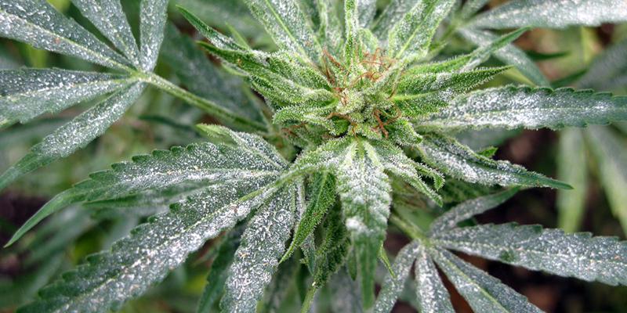
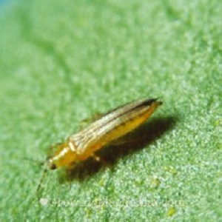
A Growers Biggest concerns
Thermally stressed plants
White mold or Mildew
Pests
Cross contamination between strains or rooms
Economic impact of the loss of a room
Continuation of a strain

Slide 9
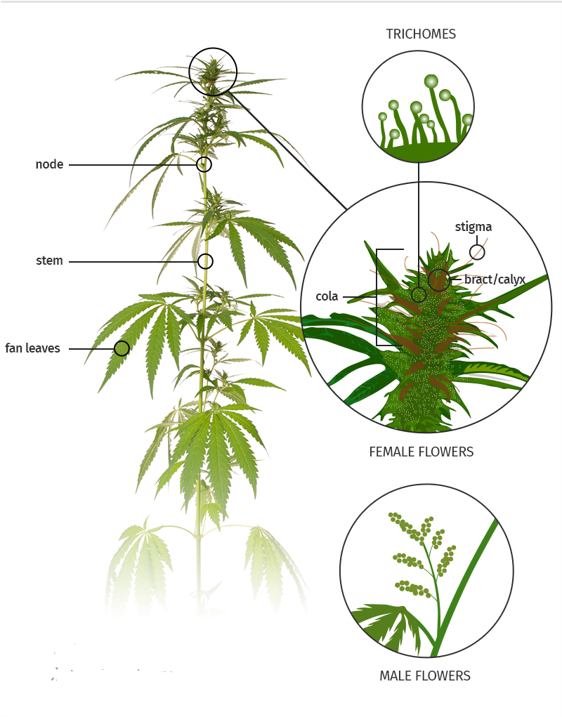
To Understand the Environmental Requirements You Must Understand the Plant
Life cycle
Transpiration rates
Impact of elevated levels of CO²
Lighting needs

Slide 10
Cannabis Cycle with Room Typical Requirements
Mother room 23.9°C (75°F) 40%RH
Clone room 26.7°C (80°F) 75%RH
Veg room 23.9°C (75°F) 50%RH
Flower room 22.2°C (72°F) 55%RH
Curing room 23.9°C (75°F) 35%RH
63 days clone to harvest

Slide 11
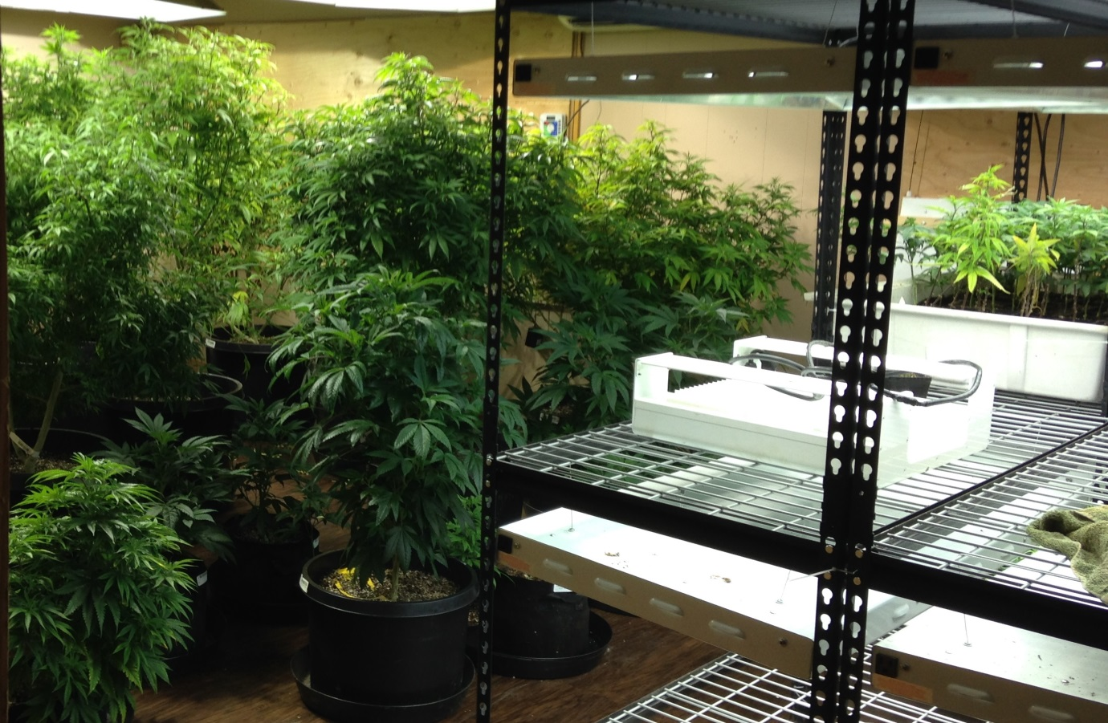
Mother Room
Mother room 23.9°C (75°F) 40%RH

Slide 12
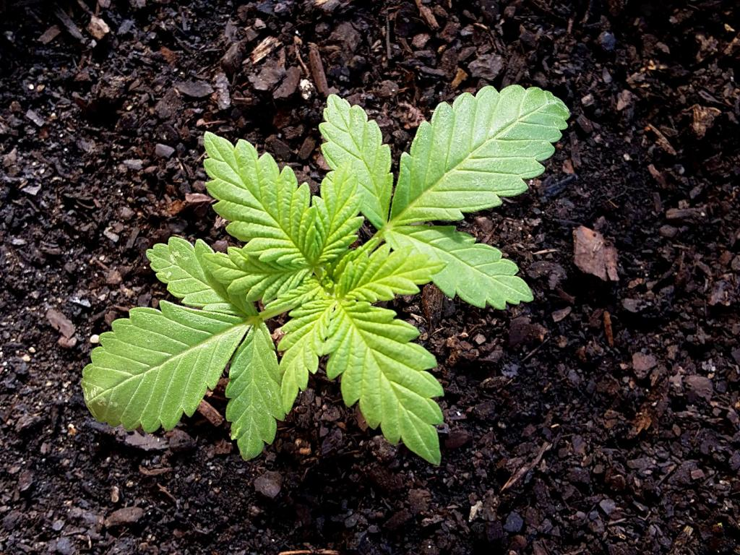
Clone Room, The Nursery
Clone room 26.7°C (80°F) 75%RH

Slide 13
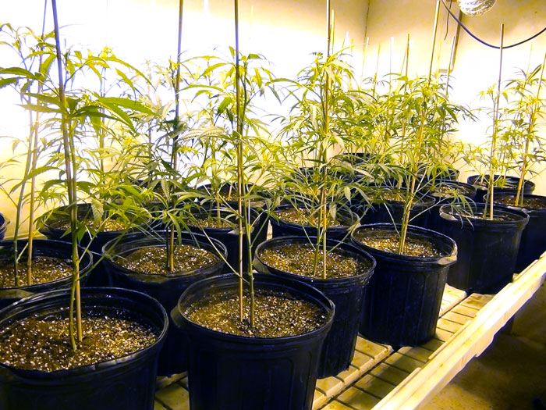
Vegetative Room, Veg Room
Vegetative room 23.9°C (75°F) 50%RH

Slide 14
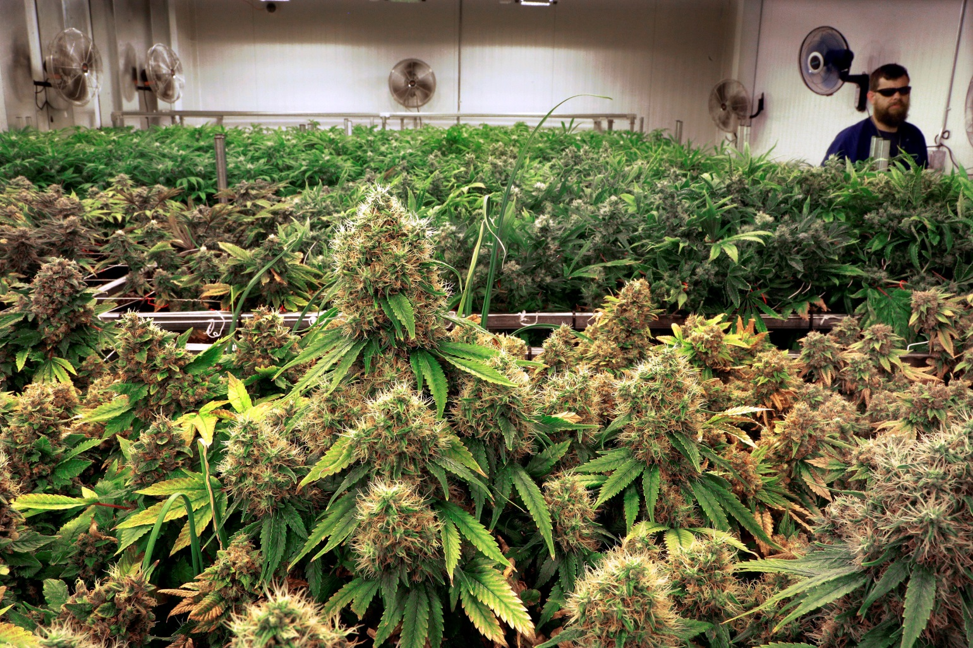
Flowering Room, Bloom Room
Flowering room 22.2°C (72°F) 55%RH

Slide 15
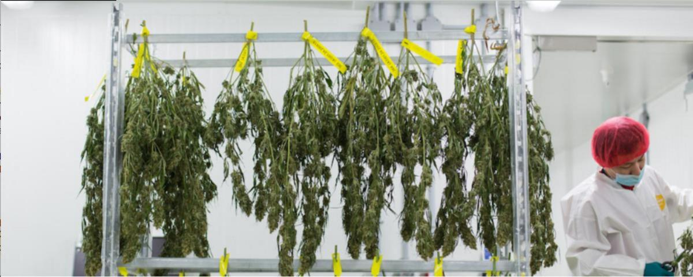
Drying Room, Curing Room
Curing room 23.9°C (75°F) 35%RH Dew Point 7.5°C (45.5°F)

Slide 16
Types of Systems
Direct Expansion
Chilled Water
Desiccant dehumidification
Ultrasonic or steam canister humidification
Requires tight control of conditions
Co² control system
Air scrubbers
Combinations of multiple types of units

Slide 17
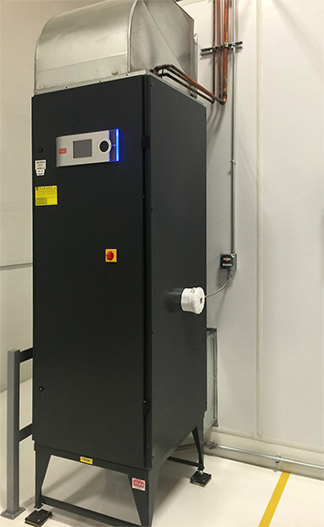
Custom Medical Cannabis Features
Enhanced dehumidification

Slide 18
Custom Medical Cannabis Features
Ultraviolet lighting

Slide 19
Custom Medical Cannabis Features
CO² monitoring, Control,
and alarms

Slide 20
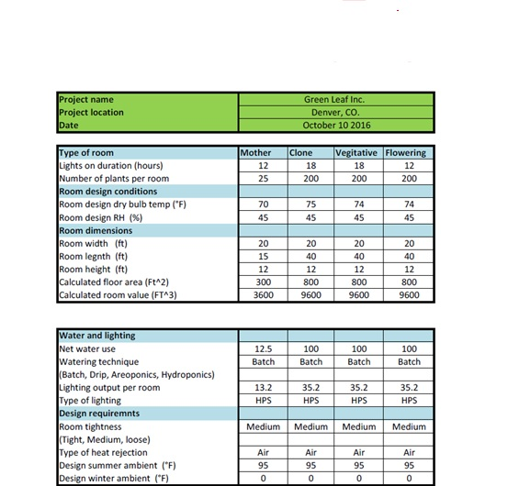
What Information Does a Engineer Need?

Slide 21
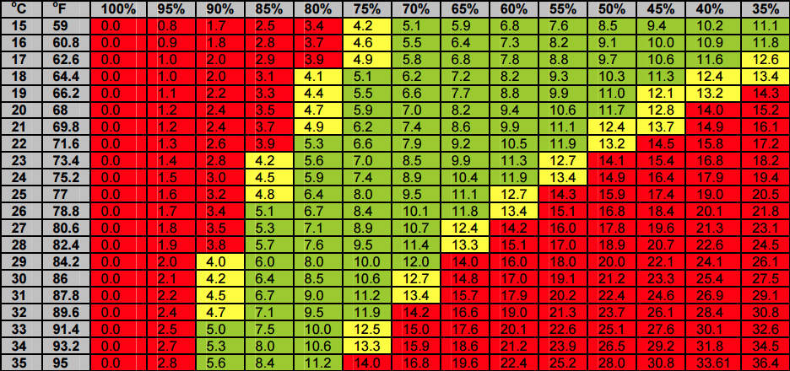
Vapor Pressure Deficit
Stay in the green zone for healthy plants
*Chart courtesy of Big Buds Newsletter

Slide 22
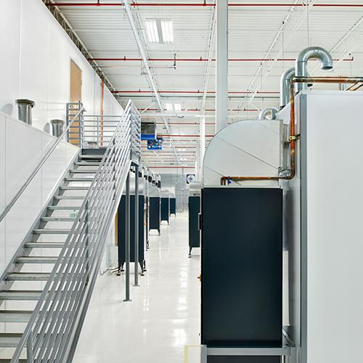
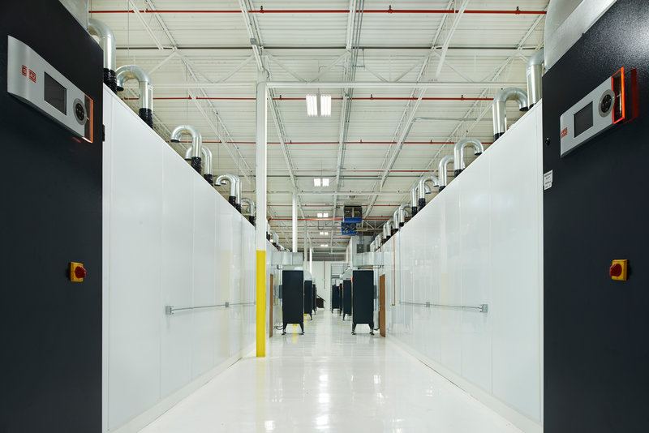
What Does a Typical Grow Site Look Like?

